Slide 1


ACCT 2003 Intermediate Financial Accounting 中级财务会计
THE HITSZ
SCHOOL OF ECONOMICS
AND MANAGEMENT
授课人：墙伟
2024.09.18

Slide 2

LEARNING OBJECTIVES
CHAPTER 10
Acquisition and
Disposition of Property,
Plant, and Equipment
After studying this chapter, you should be able to:
Identify property, plant, and equipment and its related costs.
Discuss the accounting problems associated with interest capitalization.
Explain accounting issues related to acquiring and valuing plant assets.
Describe the accounting treatment for costs subsequent to acquisition.
Describe the accounting treatment for the disposal of property, plant, and equipment.

Slide 3
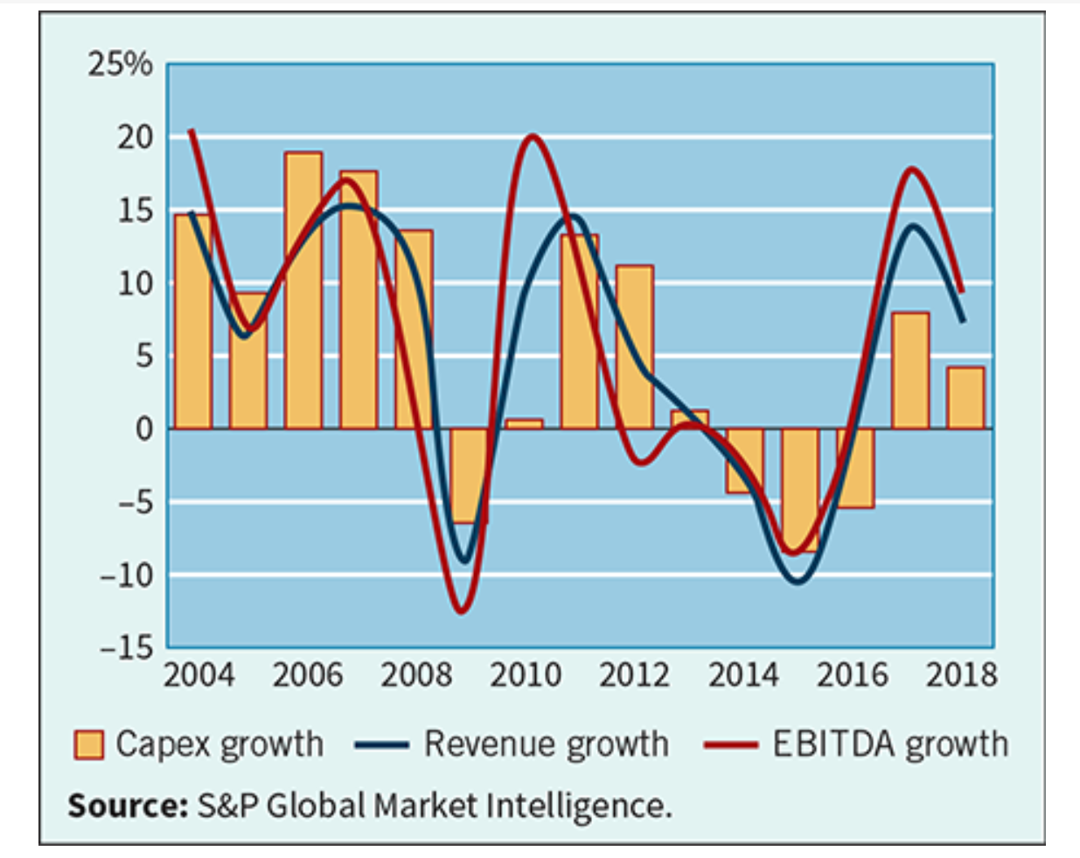
Capital expenditures of U.S. companies
The adjacent graph shows that global capital expenditures are highly variable and tend to follow the trends in revenue and EBITDA growth.
Notes:
As mentioned previously, too much or too little capital spending by companies can lead to decreased cash flows, loss of competitive position, and diminished pricing power.
Relationships between capital-expenditures-to-sales and capital-expenditures-to-depreciation, as well as free cash flow, provide insight into the underlying financial flexibility of a company.

Slide 4
LEARNING OBJECTIVE 1
Identify property, plant, and equipment and its related costs.
不动产、厂房和设备确认和计量

Slide 5
Property, Plant, and Equipment 不动产、厂房和设备
Property, plant, and equipment are assets of a durable nature. Other terms commonly used are plant assets and fixed assets.
“Used in operations” and not for resale.
Long-term in nature and usually depreciated.
Possess physical substance.
Includes:
Land,
Building structures (offices, factories, warehouses), and
Equipment (machinery, furniture, tools).
LO 1
Notes:
Property, plant, and equipment is defined as tangible assets that are held for use in production or supply of goods and services, for rentals to others, or for administrative purposes; they are expected to be used during more than one period.
They are acquired for use in operations and not for resale. Only assets used in normal business operations are classified as property, plant, and equipment. For example, an idle building is more appropriately classified separately as an investment. Property, plant, and equipment held for possible price appreciation are classified as investments. In addition, property, plant, and equipment held for sale or disposal are separately classified and reported on the statement of financial position. Land developers or subdividers classify land as inventory.
They are long-term in nature and usually depreciated. Property, plant, and equipment yield services over a number of years. Companies allocate the cost of the investment in these assets to future periods through periodic depreciation charges. The exception is land, which is depreciated only if a material decrease in value occurs, such as a loss in fertility of agricultural land because of poor crop rotation, drought, or soil erosion.
They possess physical substance. Property, plant, and equipment are tangible assets characterized by physical existence or substance. This differentiates them from intangible assets, such as patents or copyrights. Unlike raw material, however, property, plant, and equipment do not physically become part of a product held for resale.

Slide 6

单选题
1分
Quick Check #1
Property, plant, and equipment includes
此题未设置答案，请点击右侧设置按钮
A
idle equipment awaiting sale.
B
deposits on machinery not yet received.
C
land held for possible use as a future plant site.
D
None of these answer choices are classified as property, plant, and equipment.
Submit

Slide 7
Acquisition of Property, Plant, and Equipment (PP&E)
Historical cost 历史成本 measures the cash or cash equivalent price of obtaining the asset and bringing it to the location and condition necessary for its intended use.
In general, costs include:
Purchase price, including import duties and non-refundable purchase taxes, less trade discounts and rebates.
Costs attributable to bringing the asset to the location and condition necessary for it to be used in a manner intended by the company.
LO 1
Notes:
Companies recognize property, plant, and equipment when the cost of the asset can be measured reliably and it is probable that the company will obtain future economic benefits

Slide 8
Acquisition of Property, Plant, and Equipment (PP&E)
Companies value property, plant, and equipment in subsequent periods using either the
cost method 历史成本 or
fair value (revaluation) method 公允价值.
Most companies use the cost method—it is less expensive to use because the cost of an appraiser is not needed.
In addition, the fair value method generally leads to higher asset values, higher depreciation amounts, and lower net income.
LO 1
Notes:
Companies can apply the cost or fair value method to all the items of property, plant, and equipment or to a single class or classes of property, plant, and equipment.

Slide 9
Acquisition of PP&E
Cost of Land
All expenditures made to acquire land and ready it for use. Costs typically include:
purchase price;
closing costs, such as title to the land, attorney’s fees, and recording fees;
costs of grading, filling, draining, and clearing;
assumption of any liens, mortgages, or encumbrances on the property; and
additional land improvements that have an indefinite life.
LO 1

Slide 10
Acquisition of PP&E
Cost of Land – An example
ÆON purchases land for the purpose of constructing a building, it considers all costs incurred up to the excavation for the new building as land costs. Removal of old buildings—clearing, grading, and filling—is a land cost because these activities are necessary to get the land in condition for its intended purpose. ÆON treats any proceeds from getting the land ready for its intended use, such as salvage receipts on the demolition of an old building or the sale of cleared timber, as reductions in the price of the land.
In some cases, when ÆON purchases land, it may assume certain obligations on the land, such as back taxes or liens. In such situations, the cost of the land is the cash paid for it, plus the encumbrances.
ÆON also might incur special assessments for local improvements, such as pavements, street lights, sewers, and drainage systems. It should charge these costs to the Land account because they are relatively permanent in nature.
LO 1

Slide 11
Acquisition of PP&E
Cost of Land
Improvements with limited lives, such as private driveways, walks, fences, and parking lots, are recorded as Land Improvements and depreciated.
Land acquired and held for speculation is classified as an investment.
Land held by a real estate concern for resale should be classified as inventory.
LO 1
Notes:
Removal of old buildings—clearing, grading, and filling—is a land cost because these activities are necessary to get the land in condition for its intended purpose.
ÆON treats any proceeds from getting the land ready for its intended use, such as salvage receipts on the demolition of an old building or the sale of cleared timber, as reductions in the price of the land.

Slide 12
Acquisition of PP&E
Cost of Buildings
Includes all expenditures related directly to acquisition or construction. Costs include:
materials, labor, and overhead costs incurred during construction and
professional fees and building permits.
Companies consider all costs incurred, from excavation to completion, as part of the building costs.
Is the cost of removal of the old building a cost of the land or a cost of the new building?
LO 1
Notes:
The cost of buildings depends on how the building was acquired. If purchased, cost includes the purchase price, any closing costs, and the broker’s commission.
If constructed, cost includes (a) materials, labor, and overhead costs incurred during construction; and (b) professional fees and building permits. Generally, all costs incurred, from excavation to completion, are part of the building costs. Any costs not directly attributable to getting the building ready for its intended use are not capitalized. This includes start-up costs and general administrative expenses.
But how should companies account for an old building that is on the site of a newly proposed building? Is the cost of removal of the old building a cost of the land or a cost of the new building? Recall that if a company purchases land with an old building on it, then the cost of demolition less its residual value is a cost of getting the land ready for its intended use and relates to the land rather than to the new building.

Slide 13
Acquisition of PP&E
Cost of Equipment
Include all expenditures incurred in acquiring the equipment and preparing it for use. Costs include:
purchase price,
freight and handling charges,
insurance on the equipment while in transit,
cost of special foundations if required,
assembling and installation costs, and
costs of conducting trial runs.
LO 1

Slide 14
单选题
1分
Quick Check #2
The cost of equipment includes all of the following except
此题未设置答案，请点击右侧设置按钮
A
a purchase price reduced by any discount taken.
B
freight costs.
C
installation costs.
D
required maintenance costs during the first year of operations.
Submit

Slide 15
Acquisition of PP&E
E10.1: The expenditures and receipts below are related to land, land improvements, and buildings acquired for use in a business enterprise. Determine how the following should be classified:
Money borrowed to pay building contractor (signed a note)
Payment for construction from note proceeds
Cost of land fill and clearing
Delinquent real estate taxes on property assumed by purchaser
Premium on 6-month insurance policy during construction
LO 1
Notes:
Group students to discuss the questions.

Slide 16
Acquisition of PP&E
E10.1: Determine how the following should be classified:
Refund of 1-month insurance premium because construction completed early
Architect’s fee on building
Cost of real estate purchased as a plant site (land €200,000 and building €50,000)
Commission fee paid to real estate agency
Cost of razing and removing building
Installation of fences around property
LO 1

Slide 17
Acquisition of PP&E
E10.1: Determine how the following should be classified:
Proceeds from residual value of demolished building
Interest paid during construction on money borrowed for construction
Cost of parking lots and driveways
Cost of trees and shrubbery planted (permanent in nature)
Excavation costs for new building
LO 1

Slide 18
Acquisition of PP&E
Self-Constructed Assets
Costs include:
Materials and direct labor
Overhead can be handled in two ways:
Assign no fixed overhead.
Assign a portion of all overhead to the construction process.
Companies should assign to the asset a pro rata portion of the fixed overhead to determine its cost. Companies use this treatment extensively because many believe that it results in a better matching of costs with revenues.
LO 1
Notes:
Materials and direct labor used in construction pose no problem. A company can trace these costs directly to work and material orders related to the fixed assets constructed.
However, the assignment of indirect costs of manufacturing creates special problems. These indirect costs, called overhead or burden, include power, heat, light, insurance, property taxes on factory buildings and equipment, factory supervisory labor, depreciation of fixed assets, and supplies.
Companies should assign to the asset a pro rata portion of the fixed overhead to determine its cost. Companies use this treatment extensively because many believe that it results in a better matching of costs with revenues.
If the allocated overhead results in recording construction costs in excess of the costs that an outside independent producer would charge, the company should record the excess overhead as a period loss rather than capitalize it.

Slide 19
LEARNING OBJECTIVE 2
Discuss the accounting problems associated with the capitalization of borrowed funds.
借款费用资本化

Slide 20
Interest Costs
During Construction
Three approaches have been suggested to account for the interest incurred in financing the construction.
Increase to Cost of Asset
$ 0
$ ?
Capitalize no interest during construction
Capitalize all costs of funds
Capitalize actual costs incurred during construction
ILLUSTRATION 10.1
Capitalization of Interest Costs
IFRS
This approach capitalizes only borrowing costs incurred through debt financing.
LO 2
Notes:
Capitalize no borrowing costs during construction. Under this approach, interest is considered a cost of financing and not a cost of construction. Some contend that if a company had used equity financing rather than debt, it would not incur this cost. The major argument against this approach is that the use of cash, whatever its source, has an associated implicit interest cost, which should not be ignored.
Charge construction with all borrowing costs of funds employed, whether identifiable or not. This method maintains that the cost of construction should include the cost of financing, whether by cash, debt, or equity. Its advocates say that all costs necessary to get an asset ready for its intended use, including borrowing costs, are part of the asset’s cost. Interest, whether actual or imputed, is a cost, just as are labor and materials. A major criticism of this approach is that imputing the cost of equity capital is subjective and outside the framework of an historical cost system.
Capitalize only the actual borrowing costs incurred during construction. This approach agrees in part with the logic of the second approach—th see at interest is just as much a cost as are labor and materials. But, this approach capitalizes only borrowing costs incurred through debt financing. (That is, it does not try to determine the cost of equity financing.) Under this approach, a company that uses debt financing will have an asset of higher cost than a company that uses equity financing. Some consider this approach unsatisfactory because they believe the cost of an asset should be the same whether it is financed with cash, debt, or equity.

Slide 21
Interest Costs During Construction
IFRS requires — capitalizing actual interest (with modification).
Consistent with historical cost of acquiring an asset includes all costs (including borrowing costs) incurred to bring the asset to the condition and location necessary for its intended use.
Capitalization considers three items:
Qualifying assets. 符合资本化条件的资产
Capitalization period. 资本化期间
Amount to capitalize. 资本化金额
LO 2
Notes:
This method follows the concept that the historical cost of acquiring an asset includes all costs (including borrowing costs) incurred to bring the asset to the condition and location necessary for its intended use.
IFRS requires the third approach—capitalizing actual interest (with modifications) (see Underlying Concepts). This method follows the concept that the historical cost of acquiring an asset includes all costs (including borrowing costs) incurred to bring the asset to the condition and location necessary for its intended use. The rationale for this approach is that during construction, the asset is not generating revenues. Therefore, a company should defer (capitalize) borrowing costs. Once construction is complete, a company can utilize the asset in its operations. At this point, the company should report borrowing as an expense in the determination of net income. It follows that the company should expense any borrowing cost incurred in purchasing an asset that is ready for its intended use.

Slide 22
Interest Costs During Construction
Qualifying Assets 符合资本化条件的资产
Require a substantial period of time to get them ready for their intended use or sale.
Two types of assets:
Assets under construction for a company’s own use.
Assets intended for sale or lease that are constructed or produced as discrete projects (e.g., ships or real estate developments)..
Examples of assets that do not qualify for interest capitalization
assets that are in use or ready for their intended use, and
(2) inventories that are produced over a short period of time.
LO 2
Notes:
To qualify for the capitalization of borrowing costs, assets must require a substantial period of time to get them ready for their intended use or sale. Assets that qualify for borrowing cost capitalization include assets under construction for an enterprise’s own use (such as buildings, plants, and machinery) and assets intended for sale or lease that are constructed or otherwise produced as discrete projects (like ships or real estate developments).
A company capitalizes borrowing costs starting at the beginning of the capitalization period (described in the next section). Capitalization continues until the company substantially readies the asset for its intended use.
Examples of assets that do not qualify for interest capitalization are (1) assets that are in use or ready for their intended use, and (2) inventories that are produced over a short period of time.

Slide 23
单选题
1分
Quick Check #3
Assets that qualify for capitalization of borrowing costs include
此题未设置答案，请点击右侧设置按钮
A
assets under construction for a company's own use.
B
assets that are ready for their intended use in the earnings of the company.
C
assets that are not currently being used because of excess capacity.
D
All of these assets qualify for capitalization of borrowing costs.
Submit

Slide 24
Interest Costs During Construction
Capitalization Period 资本化期间
Begins when:
Expenditures for the assets are being incurred.
Activities for readying the asset for use or sale are in progress .
Interest costs are being incurred.
Ends when:
The asset is substantially complete and ready for use.
LO 2
Notes:
The period during which borrowing costs must be capitalized begins when three conditions are present: (a) expenditures for the asset are being incurred; (b) activities that are necessary to get the asset ready for its intended use are in progress, and (c) interest cost is being incurred.
Capitalization continues as long as these three conditions are present. The capitalization period ends when the asset is substantially complete and ready for its intended use.

Slide 25
Interest Costs During Construction
Amount to Capitalize 资本化金额
Capitalize the lesser of:
Actual interest cost incurred.
2. Avoidable interest - the amount of interest cost during the period that a company could theoretically avoid if it had not made expenditures for the asset.
When the project is funded by specific debt
Capitalize the actual borrowing costs incurred during the capitalization period offset by any investment income on temporary investments of funds made available from the borrowings.
When the project is funded by general debt
The average carrying amount of the project during the period is multiplied by the capitalization rate.
LO 2
Notes:
The amount of borrowing cost to be capitalized varies depending on whether there is specific debt that has been incurred to fund the project or whether the project is being funded from the general debt obligations of the company.

Slide 26
Comprehensive Example
On November 1, 2021, Shalla Company contracted Pfeifer Construction Co. to construct a building for $1,400,000 on land costing $100,000 (purchased from the contractor and included in the first payment). Shalla made the following payments to the construction company during 2022.
LO 2

Slide 27
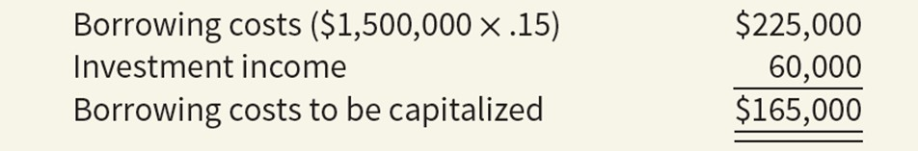
Comprehensive Example
Total Borrowing Costs- funded by specific debt
Pfeifer Construction completed the building, ready for occupancy, on December 31, 2022. Shalla had the following debt outstanding at December 31, 2022. 15 percent, $1,500,000, 3-year note to finance purchase of land and construction of the building, dated December 31, 2021, with interest payable annually on December 31. During 2021, a portion of the proceeds from the borrowing that had not yet been expended in the project were invested and earned $60,000 in interest income. The project began on January 1 and was completed on December 31, so the capitalization period was the full year of 2022.
ILLUSTRATION 10.2
LO 2
Notes:
The amount of borrowing cost to be capitalized varies depending on whether there is specific debt that has been incurred to fund the project or whether the project is being funded from the general debt obligations of the company.
When the project is funded by specific debt, the amount capitalized is the actual borrowing costs incurred during the capitalization period offset by any investment income on temporary investments of funds made available from the borrowings

Slide 28
Comprehensive Example
Shalla records the following journal entries during 2022:
Date | Account | Debit | Credit
January 1 Land 无形资产——土地使用权 100,000
Construction in Process 在建工程 110,000
Cash 银行存款 210,000
March 1 Construction in Process 在建工程 300,000
Cash 银行存款 300,000
May 1 Construction in Process 在建工程 540,000
Cash 银行存款 540,000
December 31 Construction in Process 在建工程 450,000
Cash 银行存款 450,000
Construction in Process 在建工程
(Capitalized borrowing costs) 165,000
Cash 银行存款 165,000
Buildings 固定资产——楼宇XX 1,565,000
Construction in Process 在建工程 1,565,000
LO 2

Slide 29
Comprehensive Example
Project Funded by General Debt
When the project is funded by general debt, some additional calculations and steps are included in the process. To illustrate, assume the same facts as the previous illustration, but, instead of any specific debt, the project is funded by the general debt of the company. Assume that Shalla had the following two debt obligations outstanding during 2022.
General Debt
10 percent, $1,000,000, 5-year note payable, dated December 31, 2018, with interest payable annually on December 31.
12 percent, $1,500,000, 10-year bonds issued December 31, 2017, with interest payable annually on December 31.
When the project is funded by general debt, the company will need to determine the average carrying amount of the project during the period.
LO 2

Slide 30
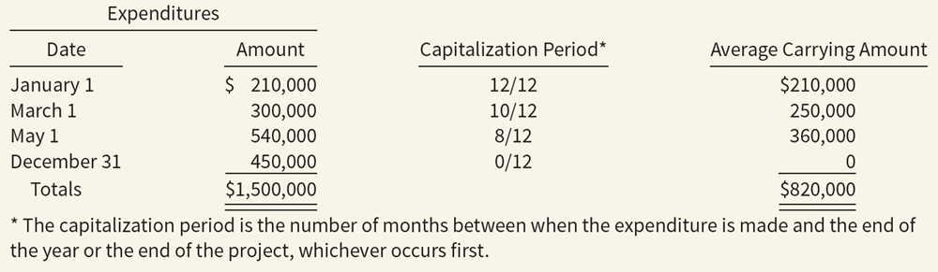
Comprehensive Example
Average Carrying Amount of Calculations
ILLUSTRATION 10.3
LO 2

Slide 31
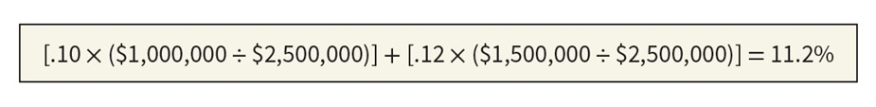

Comprehensive Example
Capitalization Rate
The second amount that is needed when borrowing costs from general debt are being used, and there is more than one general debt obligation, is the weighted-average borrowing costs. This amount is called the capitalization rate and is computed as follows.
By combining these two amounts, the amount of borrowing cost available for capitalization is now computed.
The final step when the borrowing cost of general debt is used is to apply the constraint that the amount capitalized cannot exceed the actual borrowing costs incurred during the period. In 2022, total borrowing costs were $280,000 [($1,000,000 x .10) + $1,500,000 x .12)]. The amount capitalized will be lower of actual, or the amount computed by multiplying the average carrying amount by the capitalization rate.
LO 2

Slide 32
Comprehensive Example
December 31, 2022 Journal Entry
All of the other entries presented in a previous slide would be the same except for the interest entries on December 31, which would be as follows.
Date | Account | Debit | Credit
December 31, 2022 | Buildings (Capitalized Borrowing Cost) 固定资产——楼宇XX | 91,840
 | Interest Expense ($280,000 − $91,840) 财务费用 | 188,160
 | Cash 银行存款 |  | 280,000
LO 2

Slide 33
单选题
1分
此题未设置答案，请点击右侧设置按钮
Quick Check #4
Which of the following statements is true regarding capitalization of interest?
A
Interest cost capitalized in connection with the purchase of land to be used as a building site should be debited to the land account and not to the building account.
B
The amount of interest cost capitalized during the period should not exceed the actual interest cost incurred.
C
When excess borrowed funds not immediately needed for construction are temporarily invested, any interest earned should not be offset against interest cost incurred when determining the amount of interest cost to be capitalized.
D
The minimum amount of interest to be capitalized is determined by multiplying the capitalization rate by the amount of total expenditures on qualifying assets during the period.
Submit

Slide 34
Comprehensive Example
Project Funded by a Blend of Specific Debt and General Debt
Specific Construction Debt
15 percent, $750,000, 3-year note payable to finance purchase construction of the building, dated December 31, 2021, with interest payable annually on December 31. Idle funds from this borrowing were invested during early 2022 and earned $40,000 in investment income.
Other Debt
10 percent, $500,000, 5-year note payable, dated December 31, 2018, with interest payable annually on December 31.
12 percent, $1,500,000, 10-year bonds issued December 31, 2017, with interest payable annually on December 31.
In this case, the expenditures are first allocated to the specific debt to the extent possible. Then, the remainder of the expenditures are allocated to the general debt.
LO 2

Slide 35
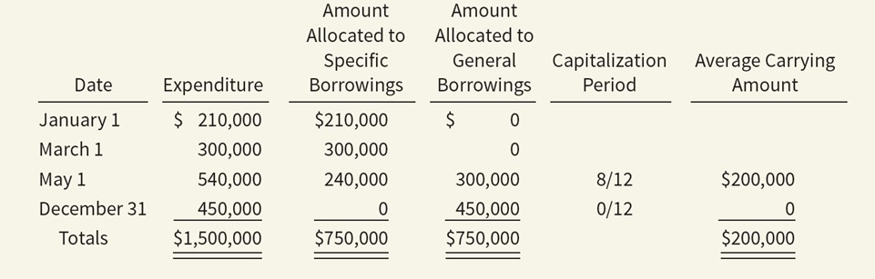
Comprehensive Example
Project Funded by a Blend of Specific Debt and General Debt—Allocation of Expenditures
ILLUSTRATION 10.4
LO 2

Slide 36
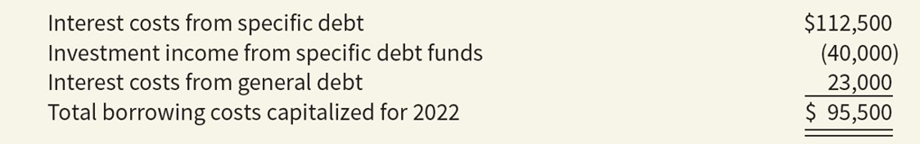
Comprehensive Example
Project Funded by a Blend of Specific Debt and General Debt—Summary of Borrowing Costs
The borrowing costs of the specific debt for this project is $72,500 based on the borrowing costs of $112,500 ($750,000 x .15) less the investment income of $40,000.
The capitalization rate on the general debt is 11.5% [(.10 x ($500,000 ÷ $2,000,000)] + [.12 x ($1,500,000 ÷ $2,000,000)]. This results in a potential amount of borrowing costs to be capitalized of $23,000 ($200,000 x .115). Since this amount is lower than the actual borrowing costs of the general debt of $230,000 [($500,000 x .10) + ($1,500,000 x .12)], $23,000 will be capitalized from the general borrowings.
ILLUSTRATION 10.5
LO 2

Slide 37
Comprehensive Example
Project Funded by a Blend of Specific Debt and General Debt—December 31 Journal Entry
Date | Account | Debit | Credit
December 31, 2022 | Buildings (Capitalized Borrowing Cost) ($72,500 + $23,000) 固定资产——楼宇XX | 95,500
 | Interest Expense ($23,000 − $23,000 ) 财务费用 | 207,000
 | Cash ($112,500 + $230,000-40000) 银行存款 |  | 302,500
LO 2

Slide 38
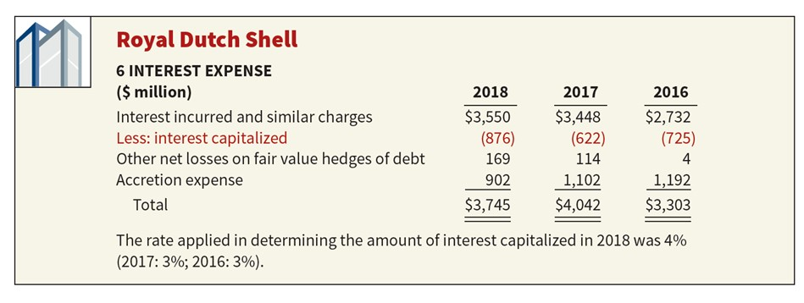
Borrowing Cost Disclosures
For each period, an entity will disclose both the amount of borrowing costs capitalized during the period and the capitalization rate used to determine the amount of borrowing costs eligible for capitalization.
ILLUSTRATION 10.6
LO 2

Slide 39


感谢您的参与！
THE HITSZ
SCHOOL OF ECONOMICS
AND MANAGEMENT

